Slide 1
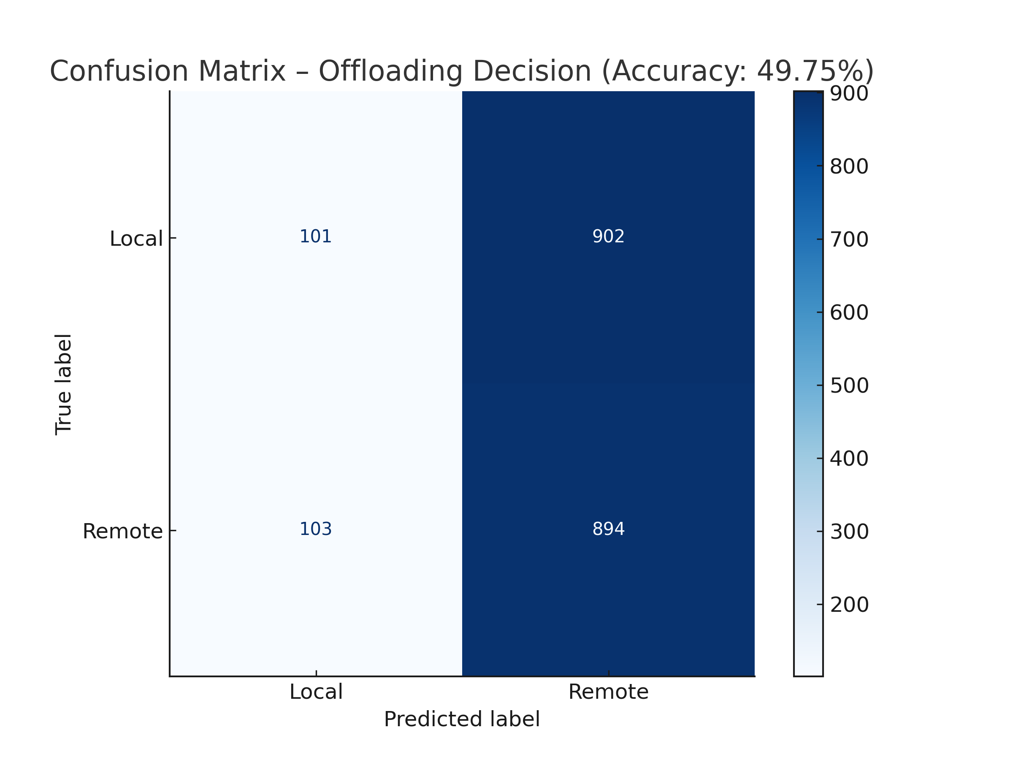
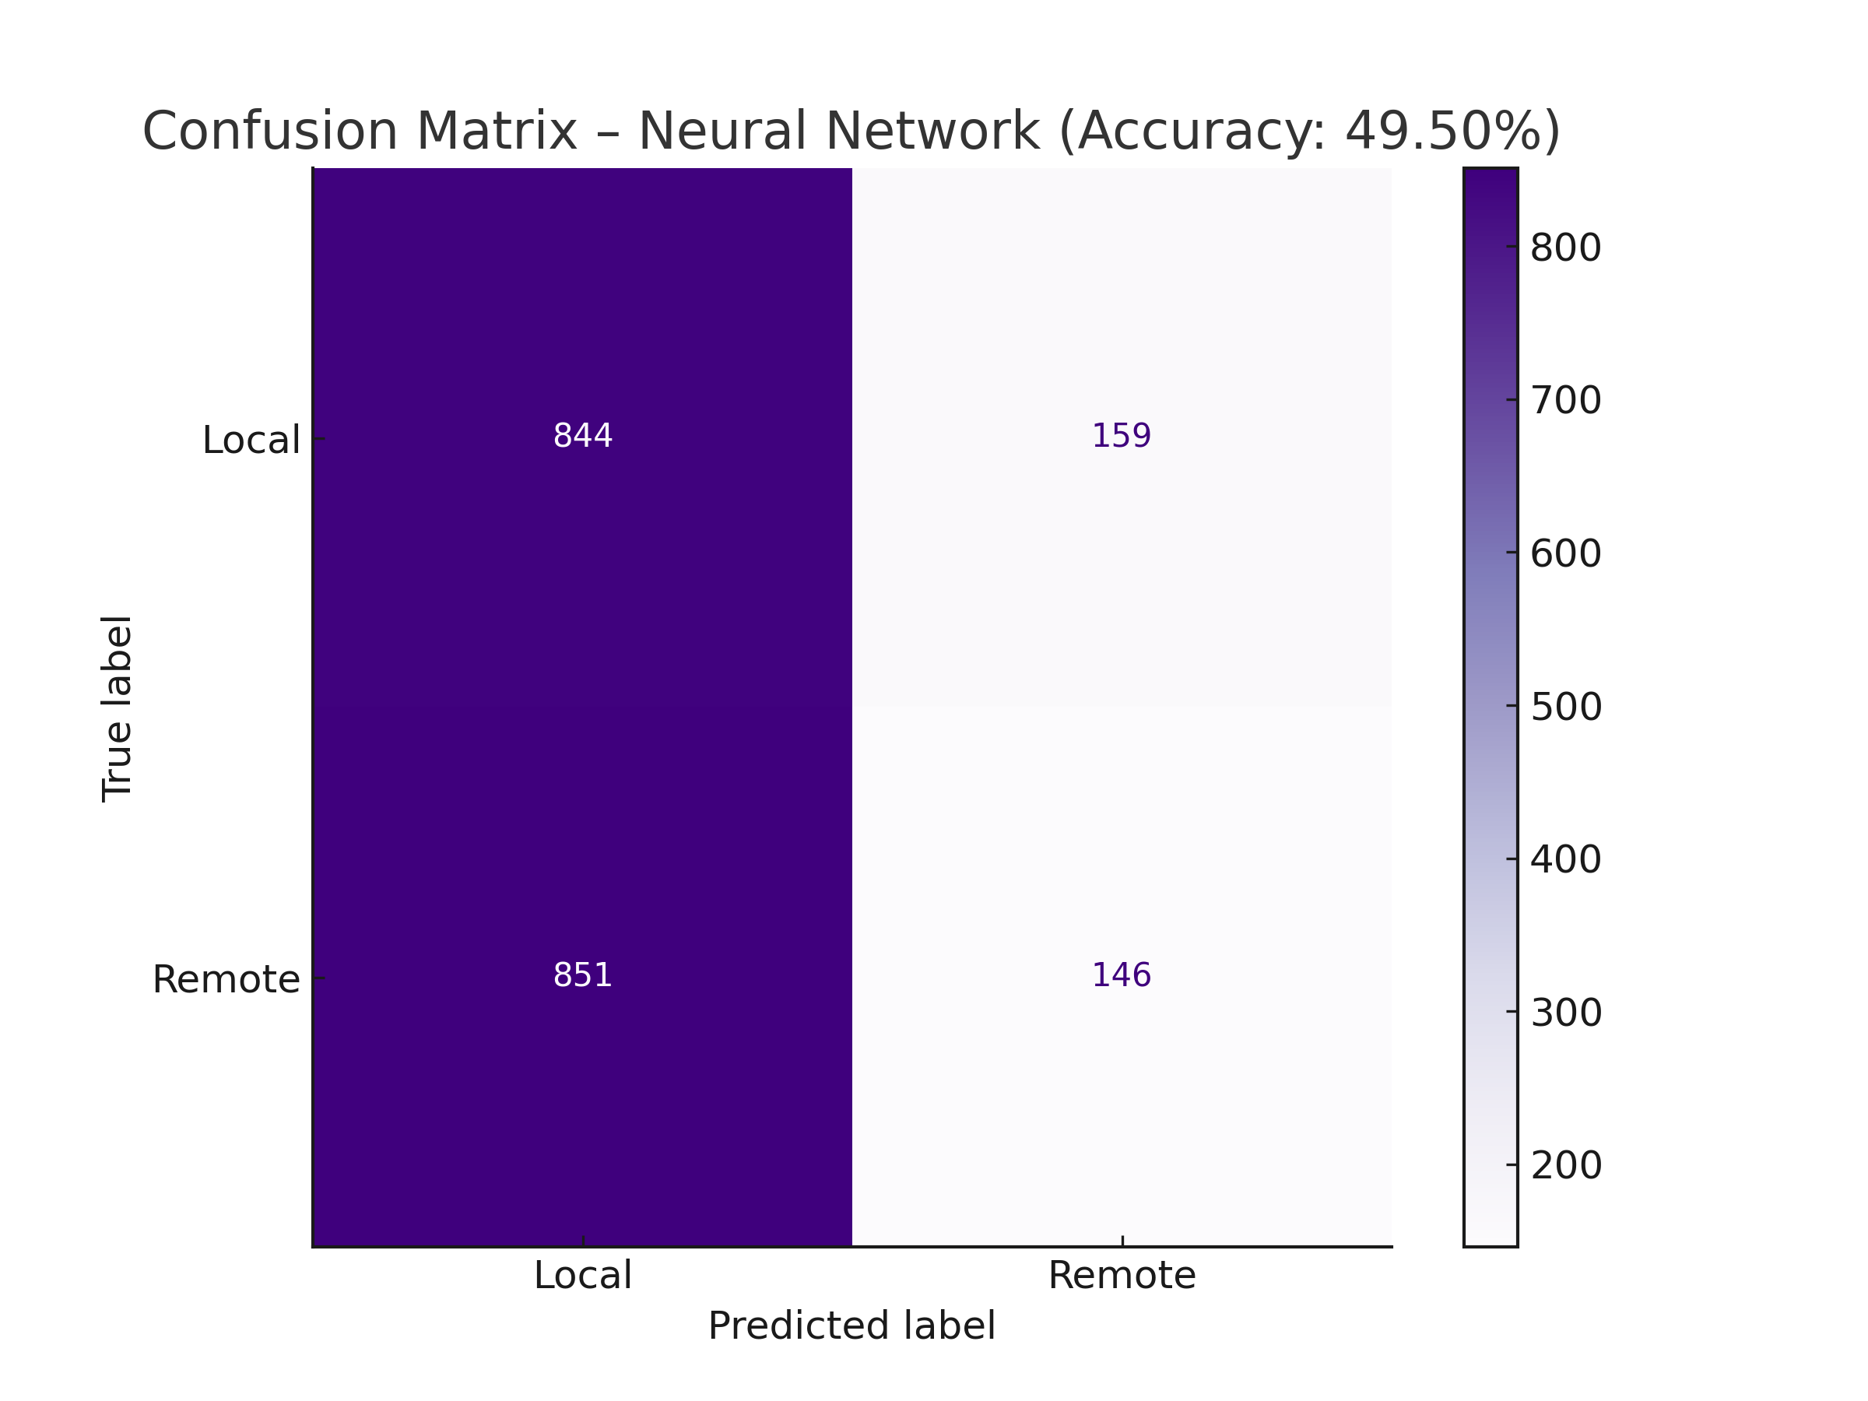
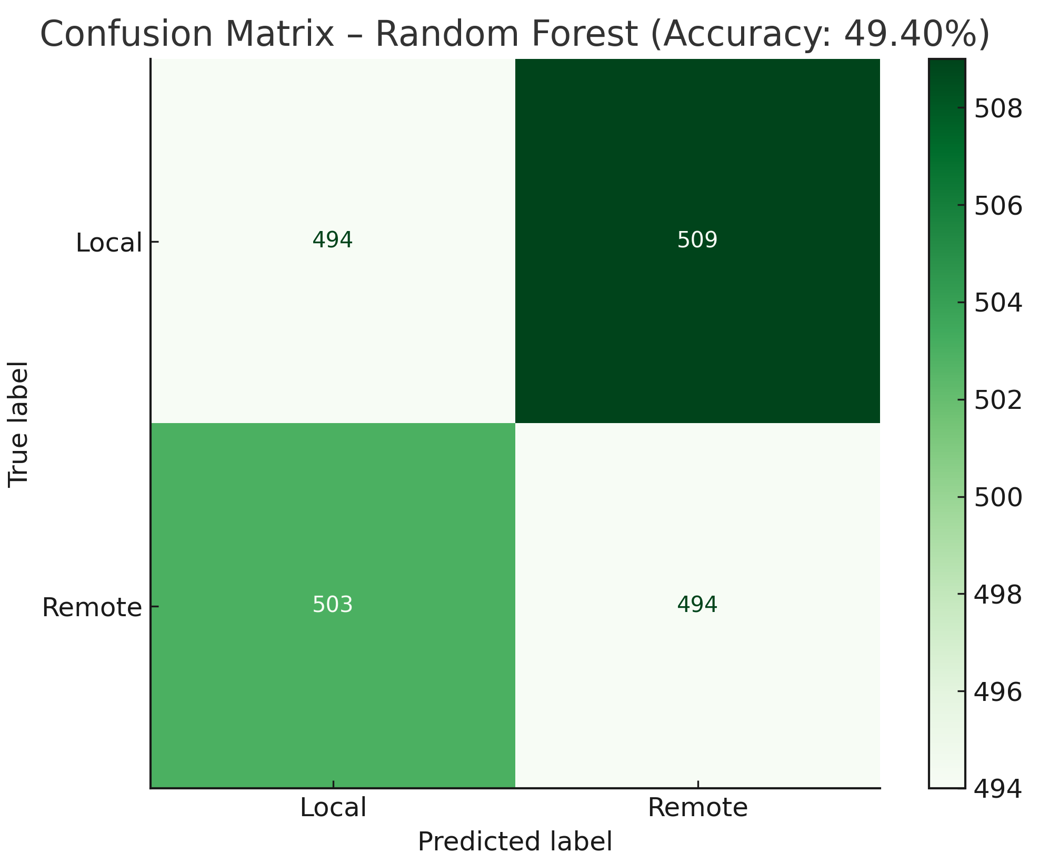
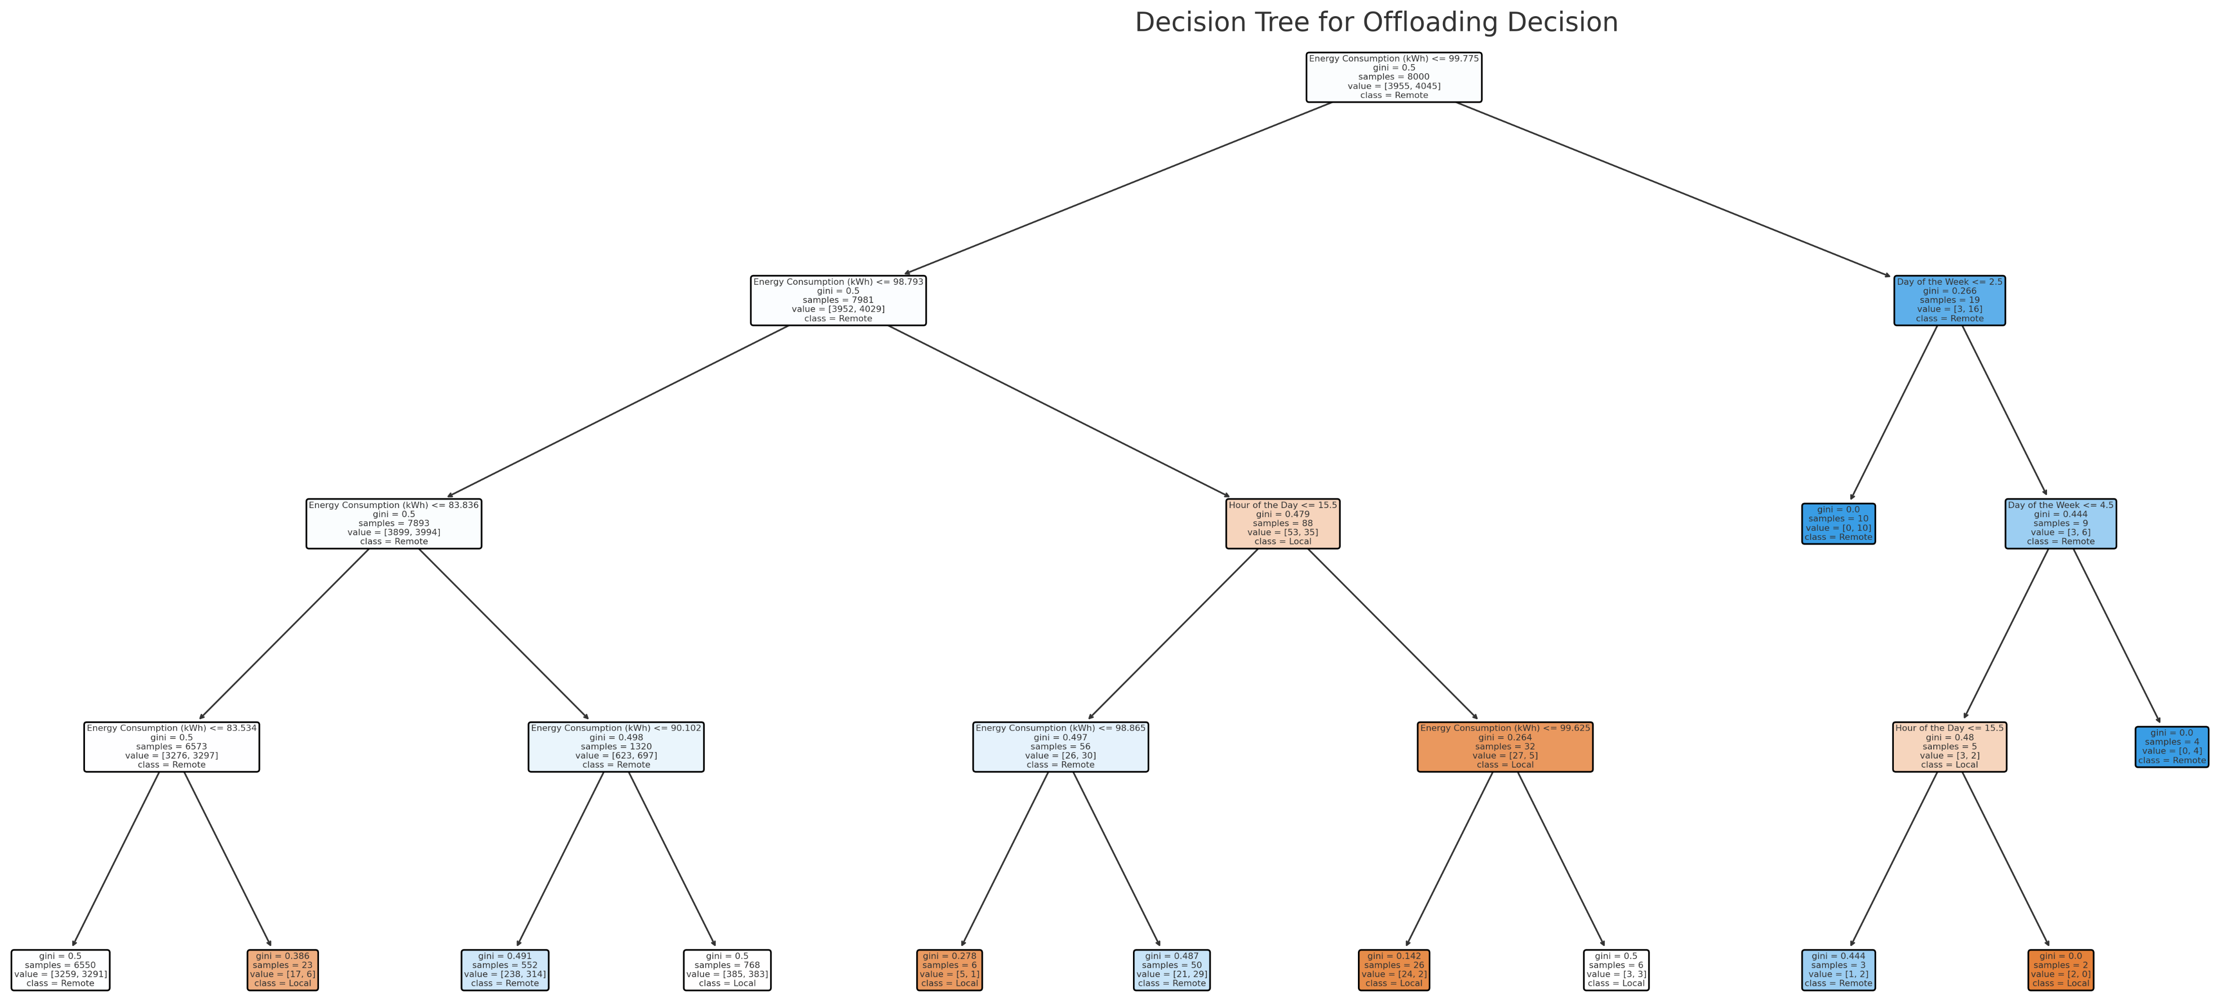
An Example for
✅ Model Evaluation on Test Data:
Accuracy: 49.75%
Precision (macro average): 49.64%
Recall (macro average): 49.87%
F1-score (macro average): 40.38%
🔁 Cross-Validation (5-fold):
Mean CV Accuracy: 50.13%
Standard Deviation: ±0.86%
Model | Accuracy | Precision (macro) | Recall (macro) | F1-score (macro)
Decision Tree | 49.75% | 49.64% | 49.87% | 40.38%
Random Forest | 49.40% | 49.40% | 49.40% | 49.40%
Neural Network | 49.50% | 48.83% | 49.40% | 42.50%

Slide 2
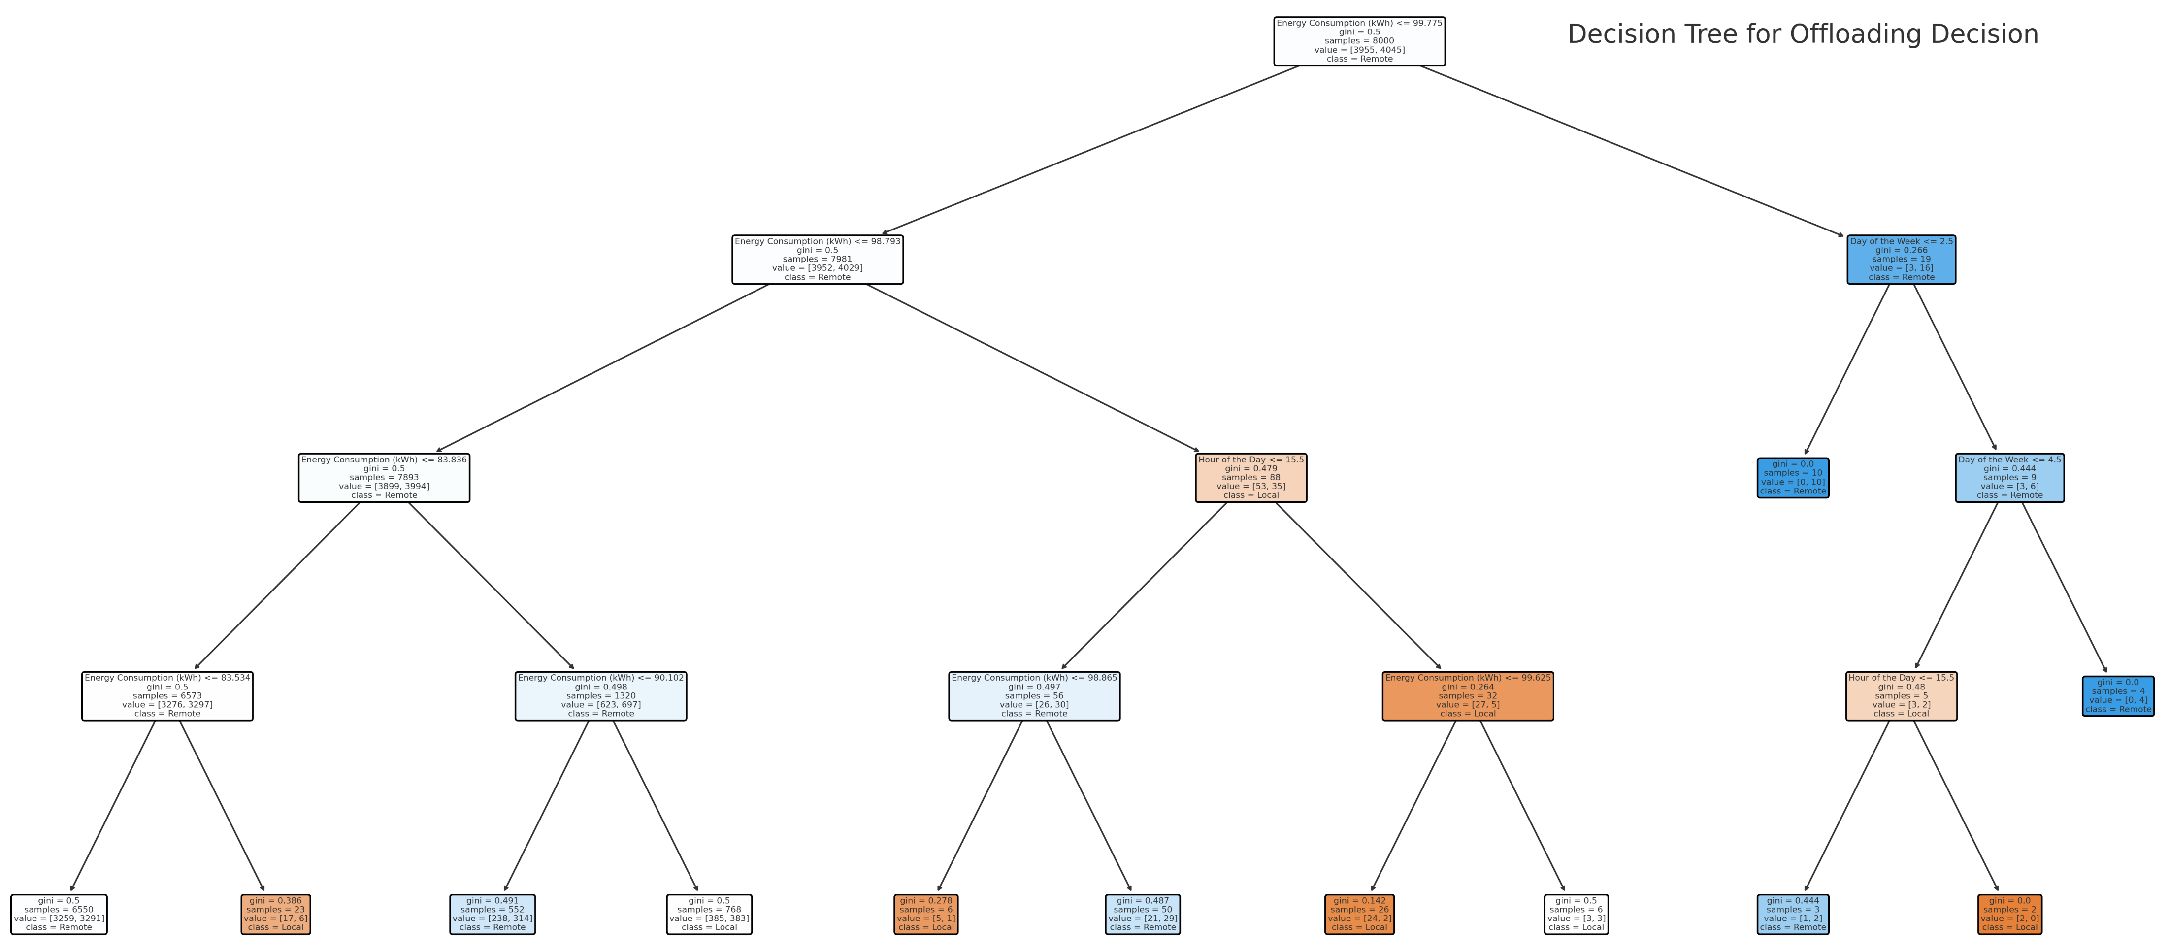
Bachelor Thesis: Business IoT Issues for the Automation of Residential Buildings, Mahdi Houshangi
Notes:
A sample Decision Tree

